Slide 1
Cyber Offences

Slide 2
Introduction
Understand different types of cyber attacks
Overview of the steps in planning cybercrime
Understand tools used for gathering information about the target. etc
Hackers :
Very talented, smart people who understand computers better than others
Hackers enjoy to learn and experimenting with the computers
Crackers :
“Breaks into computers”
Phreakers :
Breaks into phone lines.

Slide 3
Cybercrimes are classified as follows:
Cybercrime against individual
2. Cybercrime against property
3. Cybercrime against organization
4. Cybercrime against Society
5. Crimes emanating from Usenet newsgroup:
E-Mail Spoofing
A spoofed E-Mail is one that appears to originate from one source but actually has been sent from another source.
Spamming
People who create electronic Spam are called spammers.
Spam is the abuse of electronic messaging systems to send unsolicited bulk messages indiscriminately.
Spamming is widely detested, and has been the subject of legislation in many jurisdictions – for example, the CAN-SPAM Act of 2003.

Slide 4
Search engine spamming
Spamming is alteration or creation of a document with the intent to deceive an electronic catalog or a fi ling system.
Some web authors use “subversive techniques” to ensure that their site appears more frequently or higher number in returned search results.
Cyberdefamation
“Cyberdefamation” occurs when defamation takes place with the help of computers and/or the According to the IPC Section 499:
1. It may amount to defamation to impute anything to a deceased person, if the imputation would harm the reputation of that person if living, and is intended to be hurtful to the feelings of his family or other near relatives.
2. It may amount to defamation to make an imputation concerning a company or an association or collection of persons as such.
3. An imputation in the form of an alternative or expressed ironically, may amount to defamation.
4. No imputation is said to harm a person’s reputation unless that imputation directly or indirectly, in the estimation of others, lowers the moral or intellectual character of that person, or lowers the character of that person in respect of his caste or of his calling, or lowers the credit of that person, or causes it to be believed that the body of that person is in a loathsome state or in a state generally considered as disgraceful.
The law on defamation attempts to create a workable balance between two equally important human rights
The right to an unimpaired reputation
The right to freedom of expression

Slide 5
Internet Time Theft
Internet time theft occurs when an unauthorized person uses the Internet hours paid for by another person.
It comes under hacking because the person gets access to someone else’s ISP user ID and password, either by hacking or by gaining access to it by illegal means
Salami Attack/Salami Technique
These attacks are used for committing financial crimes.
No account holder will probably notice this unauthorized debit, but the bank employee will make a sizable amount every month.
Data Diddling
A data diddling attack involves altering raw data just before it is processed by a computer and then changing it back after the processing is completed.
Electricity Boards in India have been victims to data diddling programs inserted when private parties computerize their systems.

Slide 6
Forgery
Forging counterfeit currency notes, postage and revenue stamps, marksheets, etc. using sophisticated computers, printers and scanners.
Web Jacking
Web jacking occurs when someone forcefully takes control of a website (by cracking the password and later changing it).
Newsgroup Spam/Crimes Emanating from Usenet Newsgroup
The advent of Google Groups, and its large Usenet archive, has made Usenet more attractive to spammers than ever.
Spamming of Usenet newsgroups actually predates E-Mail Spam.
Industrial Spying/Industrial Espionage
“Spies” can get information about product finances, research and development and marketing strategies, an activity known as “industrial spying.”
“Targeted Attacks” - applies very well to organizations that are victim of focused attacks aiming at stealing corporate data, Intellectual Property or whatever else that may yield a competitive advantage for a rival company.
There are two distinct business models for cybercrime applied to industrial spying
Selling Trojan-ware
Selling Stolen Intellectual Property.

Slide 7
Hacking
Hackers, crackers and phrackers are some of the oft-heard terms. The original meaning of the word “hack” meaning an elegant, witty or inspired way of doing almost anything originated at MIT.
Hackers write or use ready-made computer programs to attack the target computer.
They possess the desire to destruct and they get enjoyment out of such destruction.
Some hackers hack for personal monetary gains, such as stealing credit card information, transferring money from various bank accounts to their own account followed by withdrawal of money.
Online Frauds
Types of crimes under the category of hacking
Spoofing website and E-Mail security alerts
Hoax mails about virus threats
lottery frauds
Spoofing.
Spoofing websites and E-Mail security threats
Fraudsters create authentic looking websites that are actually nothing but a spoof.
The purpose of these websites is to make the user enter personal information which is then used to access business and bank accounts
This kind of online fraud is common in banking and financial sector.
It is strongly recommended not to input any sensitive information that might help criminals to gain access to sensitive information, such as bank account details, even if the page appears legitimate.

Slide 8
Virus hoax E-Mails
The warnings may be genuine, so there is always a dilemma whether to take them lightly or seriously.
A wise action is to first confirm by visiting an antivirus site such as McAfee, Sophos or Symantec before taking any action, such as forwarding them to friends and colleagues.
Lottery frauds
Typically letters or E-Mails that inform the recipient that he/she has won a prize in a lottery.
To get the money, the recipient has to reply, after which another mail is received asking for bank details so that the money can be directly transferred.
Spoofing
A hacker logs-in to a computer illegally, using a different identity than his own.
He creates a new identity by fooling the computer into thinking that the hacker is the genuine system operator and then hacker then takes control of the system.
Pornographic Offenses
“Child pornography” includes:
1. Any photograph that can be considered obscene and/or unsuitable for the age of child viewer;
2. film, video, picture;
3. computer-generated image or picture of sexually explicit conduct where the production of such visual depiction involves the use of a minor engaging in sexually explicit conduct.
As the broad-band connections get into the reach of more and more homes, larger child population will be using the Internet and therefore greater would be the chances of falling victim to the aggression of pedophiles.

Slide 9
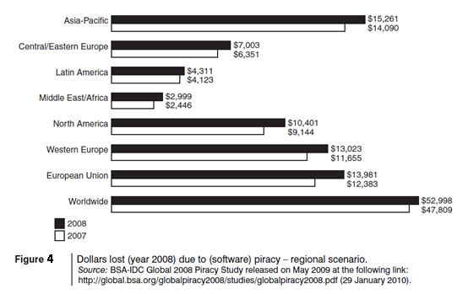
Software Piracy
Theft of software through the illegal copying of genuine programs or the counterfeiting and distribution of products intended to pass for the original.
Those who buy pirated software have a lot to lose:
getting untested software that may have been copied thousands of times over
the software, if pirated, may potentially contain hard-drive-infecting viruses
there is no technical support in the case of software failure, that is, lack of technical product support available to properly licensed users
there is no warranty protection,
there is no legal right to use the product, etc.
Economic impact of software piracy is grave (see Fig. 4).

Slide 10
Computer Sabotage
It is the use of the Internet to hinder the normal functioning of a computer system through the introduction of worms, viruses or logic bombs. It can be used to gain economic advantage over a competitor, to promote the illegal activities of terrorists or to steal data or programs for extortion purposes. Logic bombs are event-dependent programs created to do something only when a certain event (known as a trigger event) occurs. Some viruses may be termed as logic bombs.
E-Mail Bombing/Mail Bombs
It refers to sending a large number of E-Mails to the victim to crash victim’s E-Mail account or to make victim’s mail servers crash (in the case of a company or an E-Mail service provider).
Computer program can be written to instruct a computer to do such tasks on a repeated basis.
Usenet Newsgroup as the Source of Cybercrimes
Usenet is a popular means of sharing and distributing information on the Web with respect to specific topic or subjects. It is a mechanism that allows sharing information in a many-to-many manner. The newsgroups are spread across 30,000 different topics.

Slide 11

Computer Network Intrusions
Computer Networks pose a problem by way of security threat because people can get into them from anywhere.
The cracker can bypass existing password protection by creating a program to capture logon IDs and passwords.
The practice of “strong password” is therefore important.
Password Sniffing
Password Sniffers are programs that monitor and record the name and password of network users as they login, jeopardizing security at a site.
Whoever installs the Sniffer can then impersonate an authorized user and login to access restricted documents.
Credit Card Frauds
Millions of dollars may be lost annually by consumers who have credit card and calling card numbers stolen from online databases.
Bulletin boards and other online services are frequent targets for hackers who want to access large databases of credit card information.
Identity Theft
Identity theft is a fraud involving another person’s identity for an illicit purpose.
This occurs when a criminal uses someone else’s identity for his/her own illegal purposes.
The cyberimpersonator can steal unlimited funds in the victim’s name without the victim even knowing about it for months, sometimes even for years!

Slide 12
How Criminals plan the attack?
Criminals use many methods and tools to identify vulnerabilities of their target.
Criminals plan attacks were categorised into
Active
Passive
Inside
Outside
Active Attacks:
Def: To alter the system
Affects: Availability, Integrity and authenticity of data.
Passive Attacks:
Def: To gain information about the target.
Affects: Confidentiality
Inside Attack :
Def: Attempted within the security perimeter of an organisation.
Affects: Access more resources than expected.
Outside attack:
Def: Attempted by a source outside the security perimeter (insider/outsider) who is indirectly associated with the organisation.
Sources: Either from internet or a remote access connection.

Slide 13
Phases to plan cyber crime
Information gathering. (passive attack)
Reconnaissance : To gain information about an enemy .
Starts with Foot printing.
Scanning and scrutinizing the information.
For the validity of the information.
To identify the existing vulnerabilities.
Launching an attack
Gaining and maintaining the system access.

Slide 14
Passive Attack
Information gathering about a target without their knowledge.
Ex: Watching a building to identify employees entering time
It is done using internet search or googling to gain individual or company information.
Google or Yahoo search to locate information about employees.
Tools:
GOOGLE EARTH: It is a virtual map of globe and geographic information program. It maps the earth by the superimposition of images obtained from satellite imagery and provides aerial photography of the globe
Ex: (www.earth.google.com).
INTERNET ARCHIVE: The internet archive is an internet library with the purpose of offering permanent access for researchers, historians and scholars to historical collections that exist in digital format (Ramot et al., 2003). It includes texts, Audio moving images and software as well as archived web pages in our collections.
Ex: (www.archiv.org).
PEOPLE SEARCH: People search provides details about personal information, date of birth, residential address, contact number etc. Ex: (www.whitepagesinc.com).
DOMAIN NAME CONFIRMATION: To perform searches for domain names using multiple keywords, this helps to find every registered domain name in “com”, “netr”, “org”, “edu” (www.namedroppers.com).
WHOIS: This is a domain registration lookup tool. This utility is used for communicating with WHOIS servers located around the world to obtain domain registration information. WHOIS supports IP address queries and automatically selects the appropriate server for IP address. This tool will lookup information on a domain IP address or a domain registration server or you can use the default option which will select a server for you (www.whois.net).
NSLOOKUP: The name nslookup means “name server lookup”, the tool is used on windows and Unix to query details, including up addresses of a particular computer and other technical details such as mail exchanger records for a domain and name severs of a domain (www.nslookup.downloadsoftware4free.com).
eMailTrackerPro: eMailTrackerPro analyzes the E-mail header and provides the IP address of the system that send the mail (www.emailtrackerpro.com).
HTTrack: This tool acts like an offline browser. It can mirror the entire website to a desktop. One can analyze the entire websites by being offline (www.httrack.com).

Slide 15
Active Attacks
ARPING: This is a network tool that
Broadcasts arp packets and receive replies similar to “ping”.
It is good for mapping a local network and finding used IP space
It broadcasts, who has an arp packet on the network and prints answers.
It is very useful when trying to pick an unused IP for a net to which routing does not exist as yet
Bing: This tool is used
for pinging the bandwidth.
It is one of the point-to-point bandwidth measurement tool
It can calculate the blank throughput between any couple of networks. (htttp:ai3.asti.dost.gov.ph/sat/bing.html).
It is also called “Rattling the doorknobs” or “Active reconnaissance”
It can provide confirmation to an attacker about security measures in place .
Tools:
Dsniff : This is network auditing tool to capture username, password and authentication information on a local subnet.
DNStracer: This tool is used
for determining the data source of a DNS server
Notifies the continuous process of DNS server
Hmap: This tool is used
To get the fingerprinting of web servers
to identify the version of server, vender of the server, model of the server and more
Nmap: This tool is used
to scan the port address of the network,
It takes the fingerprint of operating system version, service and it can scan the network rapidly (http://insecure.org/nmap).

Slide 16
Scanning and scrutinizing gathered Information
Objectives of scanning:
Port Scanning : Where information goes in and out of a computer
Identify open/close ports and services
Network Scanning: Understand IP addresses and computer network systems information.
Vulnerability Scanning: Understand the existing weaknesses in the system.
Scrutinizing : “Enumeration”
Objectives:
1. Valid user or group
Network resources and /or shared resources
OS and different applications that are running on the OS
S.No | Port Number | Port Description
1 | 1 | TCP Port service Multiplexer
2 | 18 | Message send protocol
3 | 20 | FTP data
4 | 25 | SMTP
5 | 43 | WHOIS

Slide 17
Launch the Attack
After scan and enumeration, the attack is launched using the following steps:
Crack the password
Exploit the privileges
Execute the malicious commands/applications
Hide the files
Cover the tracks like delete the access logs.
Note:
The attackers spend 90% of the time in Reconnaissance, Scanning and scrutinizing on a target.
Only 10% of the time in launching the attack.

Slide 18
Social Engineering
It is a way for criminals to gain access to information systems.
The purpose of social engineering is usually to secretly install spyware, other malicious software or to trick persons into handing over passwords and/or other sensitive financial or personal information
What are they looking for
Obtaining simple information such as your pet's name, where you're from, the places you've visited; information that you'd give out freely to your friends.
Take a close look at some of the 'secure' sites you log into. Some have a 'secret question' you have to answer, if you cannot remember your username or password. The questions seem pretty tough for an outsider looking into trying to hack into your account.
What's the name of your first pet?
What is your maiden name?
When was your mother/father born?
Where were you born?
Do these sound familiar?

Slide 19
Social Engineering
It is the “technique to influence” and “persuasion to deceive” people to obtain the information or perform some action.
Social engineers exploit the natural tendency of a person to trust social engineers’ word, rather than exploiting computer security holes.
Social engineering involves gaining sensitive information or unauthorized access privileges by building inappropriate trust relationships with insiders.
The sign of truly successful social engineers is that they receive information without any suspicion.
Classification of Social Engineering
1. Human-Based Social Engineering
Human-based social engineering refers to person-to-person interaction to get the required/desired information.
2. Computer-Based Social Engineering
Computer-based social engineering refers to an attempt made to get the required/desired information by using computer software/Internet.

Slide 20
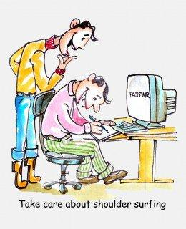
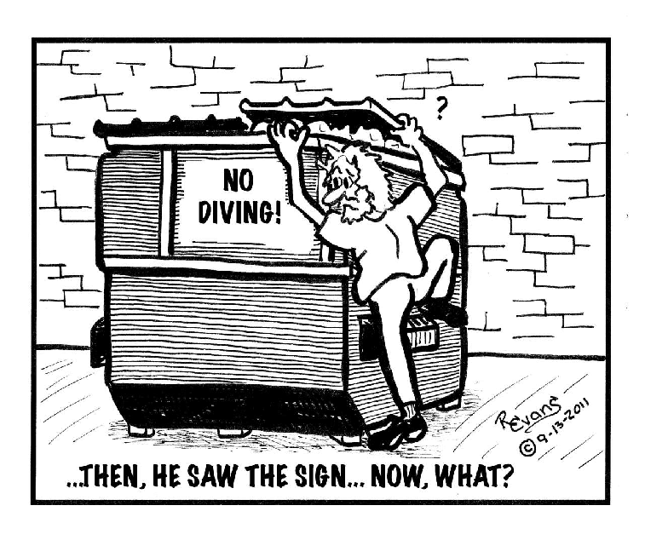
Human Based (Non Technical)
Impersonating an employee or valid user : Posing employee of same organisation.
Posing as an important user : Pretend to be an important user
Using a third person : By authorised source to use system
Calling technical support : By using Help desk
Shoulder surfing : By watching over a person shoulder
Dumpster diving : Looking in trash for information

Slide 21
2. Computer Based Social Engineering
Fake EMails
Email Attachments
Pop-up Windows
Protecting Yourself from Social Engineering Attack
Network defenses to repel virus
Virus protection (McAfee, Norton, Symantec, etc…)
Email attachment scanning
Firewalls, etc…
Organizations must decide what information is sensitive
Security must be periodically tested
Contact your security office immediately if you have any concerns at work

Slide 22
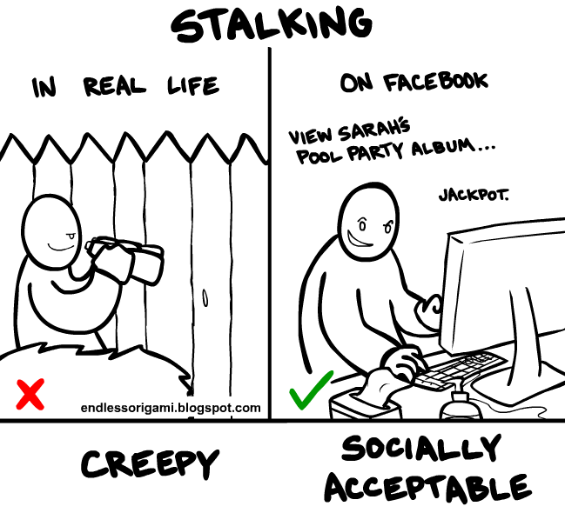
Cyber Stalking
Definition::
It is a crime in which the attacker harasses a victim using electronic communication, such as e-mail or instant messaging (IM), or messages posted to a Web site or a discussion group.
Stalking :
A cyberstalker relies upon the anonymity afforded by the Internet to allow them to stalk their victim without being detected.
Cyberstalking messages differ from ordinary spam.
Cyberstalker targets a specific victim with often threatening messages, while the spammer targets a multitude of recipients with simply annoying messages.

Slide 23
Types of Stalkers
Mainly 2 types :
Online Stalkers :
Def: Interaction with the victim using Internet.
Ex: Email, Chat
Offline Stalkers:
Def: Begin the attack using traditional methods.
Ex: Watching daily, Personal websites.
Other types :
The four most important types are:
Rejected Stalker
Resentful Stalker
Predatory Stalker
Intimacy Stalker

Slide 24
Rejected Stalker
Most common, persistent, and intrusive
Obsessed with someone who is a former romantic partner or friend, and who has ended their relationship, or indicates that he or she intends to end the relationship.
Resentful Stalker
Looking for revenge against someone who has upset them--it could be someone known to the stalker or a complete stranger.
Their behaviors are meant to frighten and distress the victim
Predatory Stalker
Least common
Are a classic sexual predator whose plan is to physically or sexually attack the victim.
Their motivated purely by the desire for sexual gratification and power over their victim
Intimacy Stalker
They seeks to establish an intimate, loving relationship with their victim.
The victim and himself were “meant to be together.”
These types of people think that the victim owes them love and affection because of all the time and effort it took for the stalker to stalk them.

Slide 25
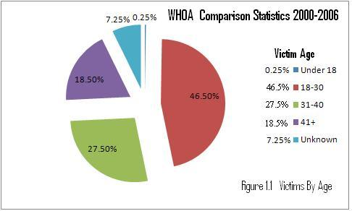
Analysis…
The majority of cyberstalkers are men and the majority of their victims are women but…..
Jane A. Hitchcock, president of WHOA says, “The most surprising thing we've seen is the rise in female cyberstalkers - this increased from 27% in 2000 to 35% in 2002 to 38% in 2003.”
According to the Working to Halt Online Abuse (WHOA) from 2000 to 2006, out of the total cases, 2036, of cyberstalking….

Slide 26
How stacking works?
In the following way
Personal information gathering about the victim.
Ex: Name, background, contact number, etc.
Establish a contact with victim through phone.
Stalkers will almost always establish a contact with the victims through EMail.
Some stalkers keep on sending repeated E-mail.
Post victims personal information on any illicit services website
Who were received information , start calling the victims on the given contact details.
Stalkers subscribe/register the E-mail account of the victim to pornographic and sex sites.
Real Life Incident:
Case study: In Delhi, 40 calls in 3 days.

Slide 27
Cybercafe and Cybercrimes
Cybercrimes such as stealing of bank passwords and subsequent fraudulent withdrawal of money have also happened through cybercafes.
Cybercafes have also been used regularly for sending obscene mails to harass people.
Indian Information Technology Act (ITA) 2000 interprets cybercafes as “network service providers” referred to under the erstwhile Section 79, which imposed on them a responsibility for “due diligence” failing which they would be liable for the offenses committed in their network.

Slide 28
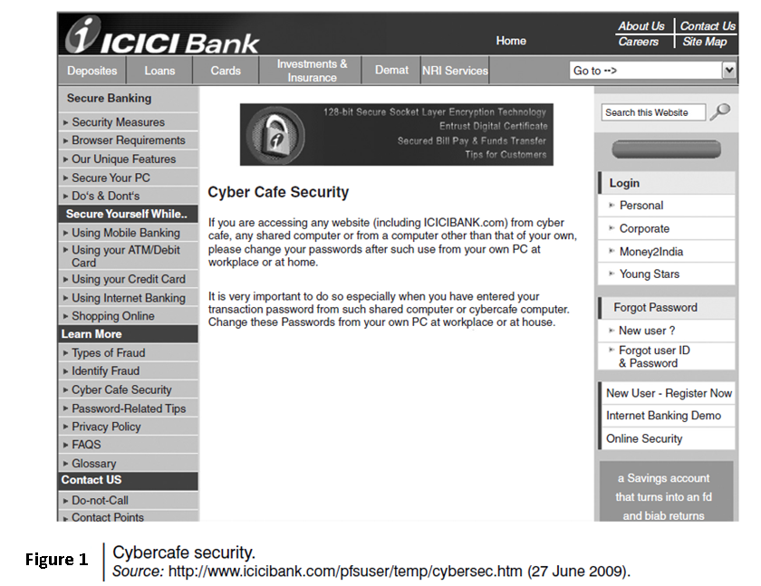

Slide 29
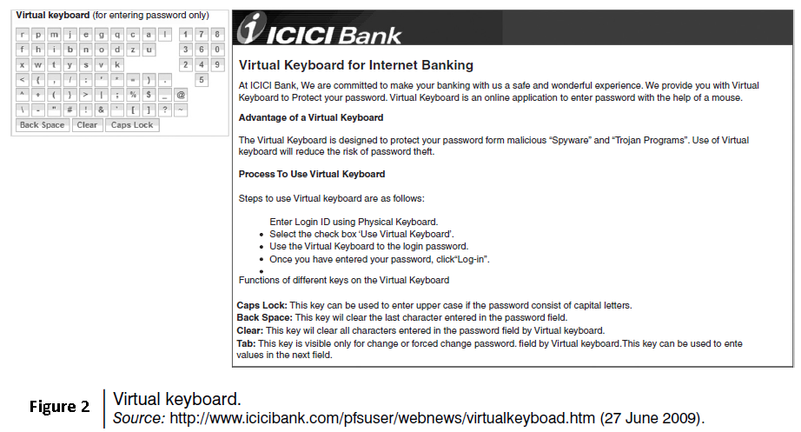

Slide 30
Cybercriminals can either install malicious programs such as keyloggers and/or Spyware or launch an attack on the target.
Here are a few tips for safety and security while using the computer in a cybercafe:
Always logout
Stay with the computer
Clear history and temporary files
Be alert
Avoid online financial transactions
Change passwords
Virtual keyboard
Security warnings

Slide 31
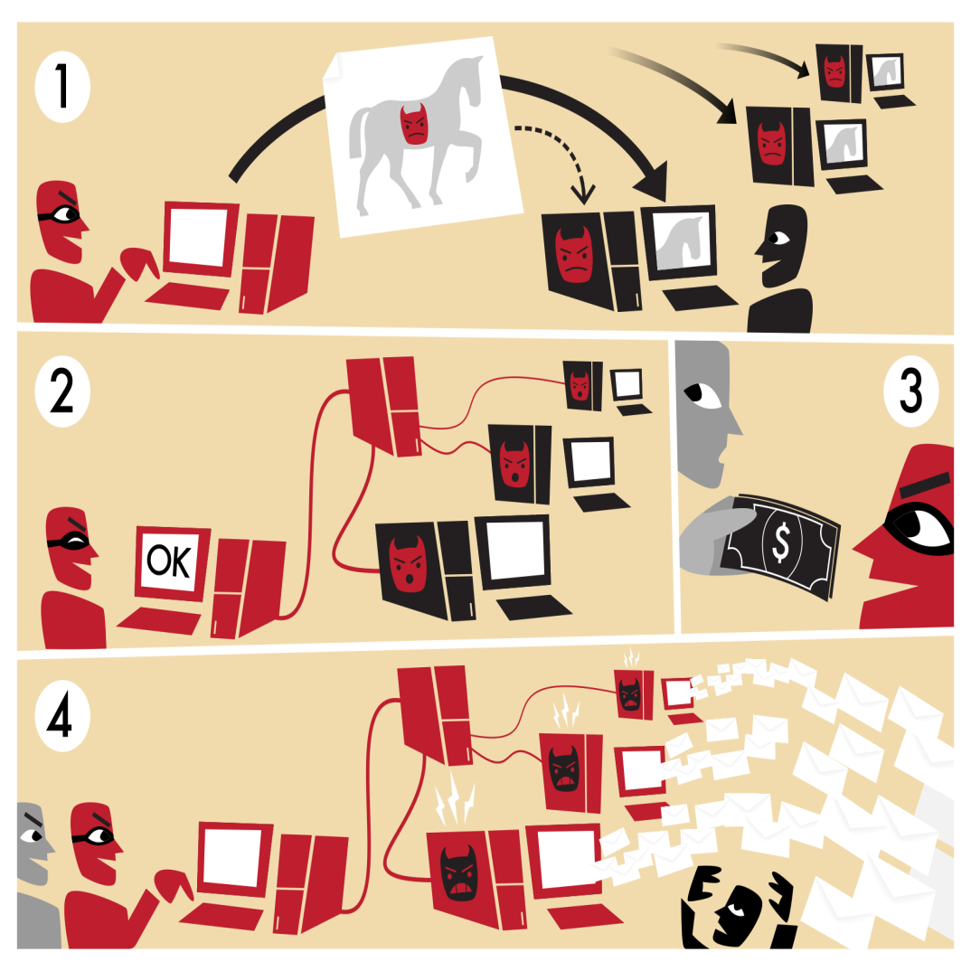
Botnet: The fuel of Cybercrime
A Botnet (also called as zombie network) is a network of computers infected with a malicious program that allows cybercriminals to control the infected machines remotely without the users’ knowledge.
Your computer system maybe a part of a Botnet even though it appears to be operating normally.
Botnets are often used to conduct a range of activities, from distributing Spam and viruses to conducting denial-of-service (DoS) attacks.
Evolution of Botnets
Motivation change in computer hacking
Vandalism 🡪 Financial gains
Loss of $67.2 billion (2006 figure)

Slide 32
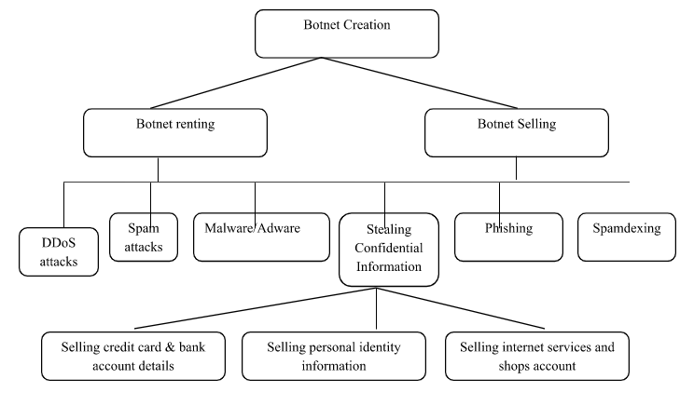
How botnets creates the business

Slide 33
One can ensure following to secure the system:
Use antivirus and anti-Spyware software and keep it up-to-date.
Set the OS to download and install security patches automatically.
Use a firewall to protect the system from hacking attacks while it is connected on the Internet.
Disconnect from the Internet when you are away from your computer.
Downloading the freeware only from websites that are known and trustworthy
Check regularly the folders in the mail box – “sent items” or “outgoing” – for those messages you did not send.
Take an immediate action if your system is infected.

Slide 34
Attack Vector
An “attack vector” is a path or means by which an attacker can gain access to a computer or to a network server to deliver a payload or malicious outcome.
Attack vectors include viruses, E-Mail attachments, webpages, pop-up windows, instant messages, chat rooms, and deception.
The most common malicious payloads are viruses, Trojan Horses, worms, and Spyware.
If an attack vector is thought of as a guided missile, its payload can be compared to the warhead in the tip of the missile.
Payload means the malicious activity that the attack performs.
It is the bits that get delivered to the end-user at the destination.

Slide 35
The attack vectors described here are how most of them are launched:
Attack by EMail
Attachments (and other files)
Attack by deception
Hackers
Heedless guests (attack by webpage)
Attack of the worms
Malicious macros
Foistware (sneakware)
Viruses

Slide 36
Cloud Security
Cloud computing services, while offering considerable benefits and cost savings makes it easier for cybercriminals to attack these systems.
Cloud computing is Internet (“cloud”)-based development and use of computer technology (“ computing”).
A cloud service has three distinct characteristics which differentiate it from traditional
hosting:
It is sold on demand
it is elastic in terms of usage
the service is fully managed by the provider.
Advantages of Cloud Computing
Cloud computing has following advantages:
1. Applications and data can be accessed from anywhere at any time.
2. It could bring hardware costs down.
3. Organizations do not have to buy a set of software or software licenses for every employee and the organizations could pay a metered fee to a cloud computing company.
4. Organizations do not have to rent a physical space to store servers and databases. Servers and digital storage devices take up space.
5. Organizations would be able to save money on IT support because organizations will have to ensure about the desktop (i.e., a client) and continuous Internet connectivity instead of servers and other hardware.

Slide 37
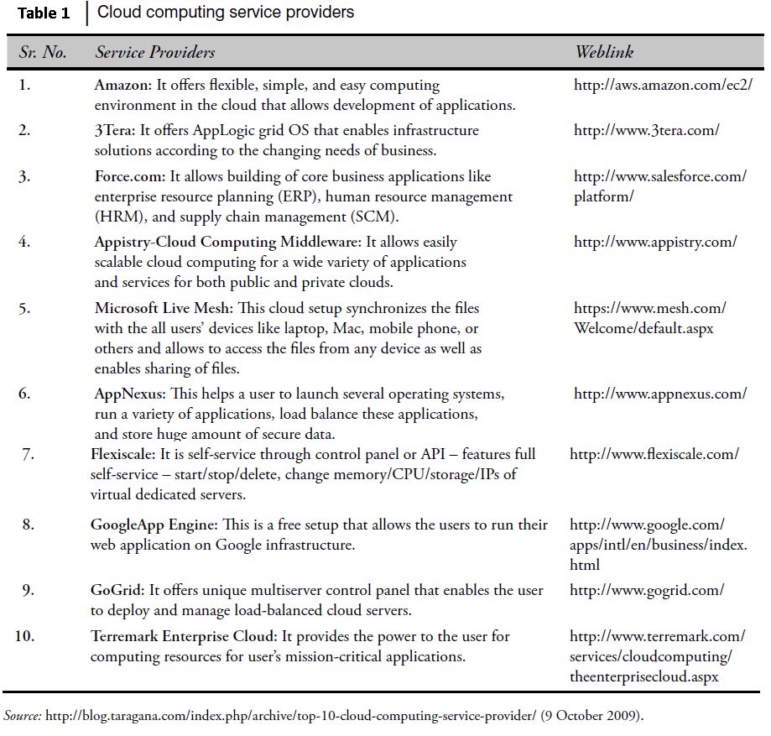
The cloud computing services can be either private or public.
A public cloud sells services to anyone on the Internet.
A private cloud is like a proprietary network or a data center that supplies the hosted services to a limited number of people.
Types of Services
Services provided by cloud computing are as follows:
Infrastructure-as-a-service (IaaS)
Platform-as-a-service (PaaS)
Software-as-a-service (SaaS)

Slide 38
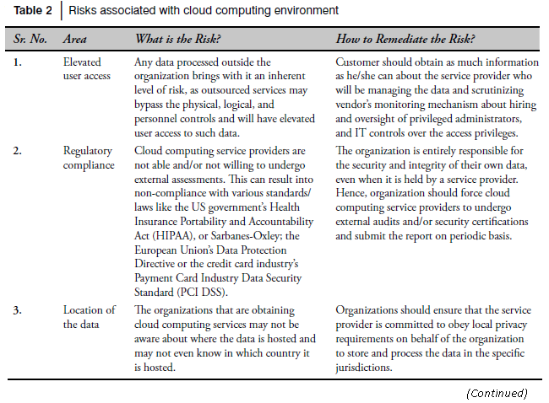
Cybercrime and Cloud Computing
Prime area of the risk in cloud computing is protection of user data.
Table 2 shows the major areas of concerns in cloud computing domain.

Slide 39
